Slide 1

@CSAW ESC 2023
Isabelle Friedfeld-Gebaide, Dan Ivanovich, Andreas D. Kellas, and Emily Soto

Slide 2
All White Party
Challenge: perform time side channel attack to recover username & PIN from Arduino
Approach: measured signals to recover information

Slide 3
All White Party
When username is guessed, Arduino paused, then vibrated
Considerations:
How do different inputs change the amount of time before/after guessed usernames?
Did the Arduino vibrate for longer on certain inputs?
Did the Arduino delay longer before vibrating on certain inputs?

Slide 4
Timing Attack: Our Model
Pigs | 10 ms
Pats | 15 ms
Parm | 20 ms
Partite | 25 ms
Party | 30 ms
In the illustrated case, checking each additional character takes an additional 5 ms

Slide 5
All White Party
Oscilloscope only shows delay relative to last peak
We only had a probe on the haptic motor
Couldn’t tell how long it took for arduino to receive signal
Solution: Send messages at constant 5 second interval
Peak lasts for 600ms
When character is correct, delay additional 300ms, and then vibrate
Allowed us to recover username
Haptic Sensor Signal per Guess
V
T
p
p
p+300ms
p-300ms
p: delay after incorrect guess

Slide 6
Operation SPItFire
Challenge: receive messages encoded via SPI through relay and sends message over serial
Approach: reverse the structure of the SPI messages to return communication

Slide 7
Initial Steps
After flashing challenge, the relay immediately starts “clicking”
Tried to decipher audio as morse code
Realized SPI was not a typo of spelling “spy”
Researched SPI Protocol
Due to the challenge statement we realized we were looking at “slave” device
Looked at the oscilloscope values as binary
Notes:
morse code from 1) audio 2) voltage difference 3) oscilloscope
determined using oscilloscope it can’t be morse code due to the high and low values not be only 3 consistent lengths
Due to the nature of SPI protocol, we know that binary is being sent to the slave device. Also when the first value starts with a rising edge the highs are 1 and lows 0

Slide 8
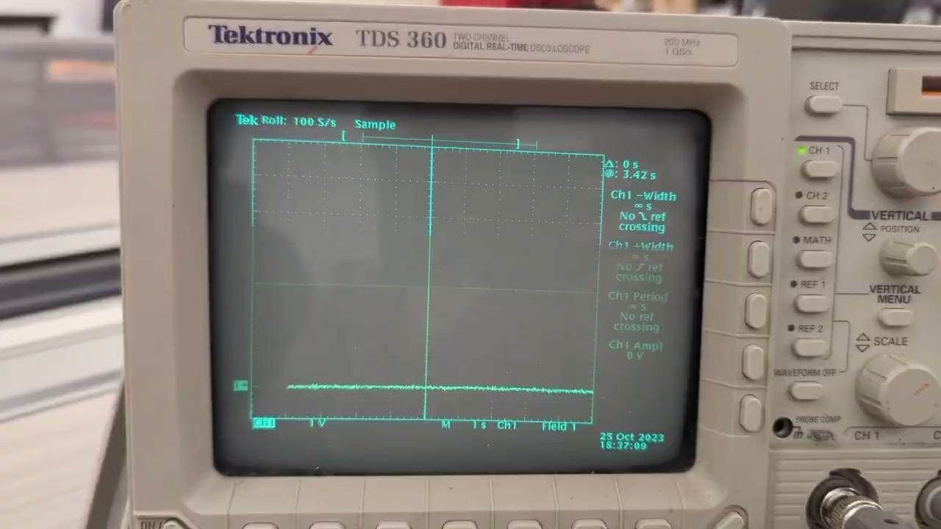
Communication Via Relay

Slide 9
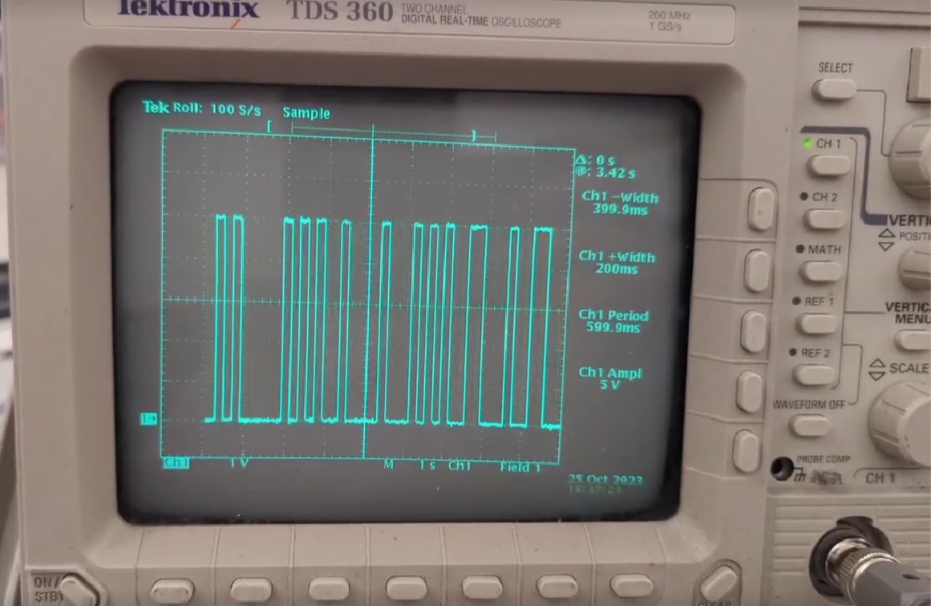
Communication Via Relay
200 ms/bit
1
1
0
0
00…

Slide 10
Structure of “HELLO” message
10100101 00000101 01001000 01000101
01001100 01001100 01001111 00111001
a5 05 48 45 4c 4c 4f 39
H
E
L
L
O
Header
=CRC-8(a50548454c4c4f)
Notes:
After confirming that there were 64 values (8x8) we translated from binary to Hex/ASCII
Due to the message we were receiving over the serial connection stating that the Arduino was “Receiving message “Hello” …” we predicted when correctly translated the message Hello should appear

Slide 11
Structure of “FLAG” message
a5 05 46 4c 41 47 00 21
F
L
A
G
[NULL]
Same Header
=CRC-8(a505464c414700)

Slide 12
Reversing the Messages for CRC-8
Please send the message "FLAG" in hex (over serial):
Error: Incorrect Length
Recieving message "HELLO"...
Please send the message "FLAG" in hex (over serial):
Error: Bad CRC

Slide 13
Received FLAG message
10100101 00001000 01010011 01010000 01111001 01000010 01010101 01010010 01001110 01100100 01111001
a5 08 53 50 79 42 55 52 4e 64 79
S
P
y
B
U
R
N
d
y
Header

Slide 14
Thank you!
Questions?

